Slide 1
Database Management System
UNIT-9
Advanced Topics

Slide 2

Looping
Outline
Web Databases
Distributed Databases
Data Warehousing and data mining
NoSQL

Slide 3
Web Databases

Slide 4
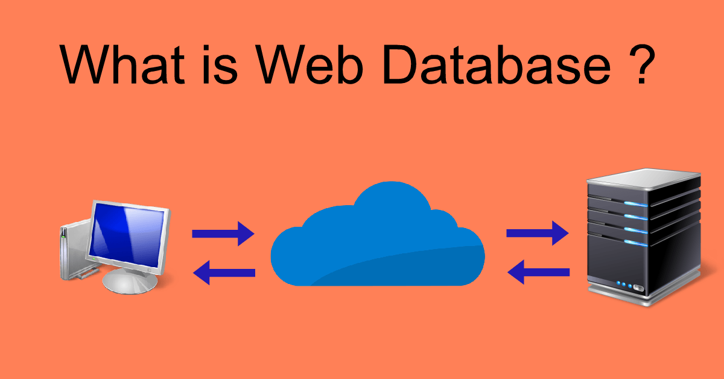
Web Databases
A web database is a system for storing and displaying information that is accessible from the Internet / web.
The database might be used for any of a wide range of functions, such as a membership database, client list, or inventory database.
A web database is a type of Web Application.

Slide 5
Types of Web Databases
1. Data Model Based:
Hierarchical Databases
Network Databases
Object-Oriented Databases
Relational Databases
Non-Relational Databases (NoSQL)
2. Location-Based:
Centralized Database
Distributed Database
3. Design Based:
Operational (OLTP) Database
Analytical (OLAP) Database
4. Hosting Based:
On-Premises Database
Cloud Database

Slide 6
Distributed Databases

Slide 7
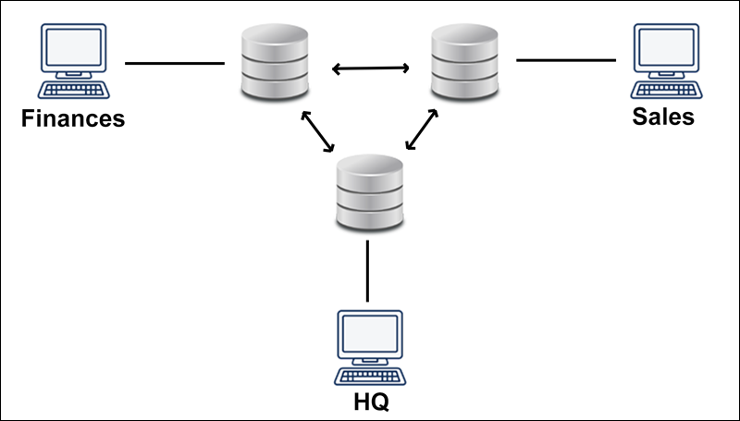
Distributed Databases
A distributed database is a database that stores data in multiple locations instead of one location.
This means that rather than putting all data on one server or on one computer, data is placed on multiple servers or in a cluster of computers consisting of individual nodes.

Slide 8
Data warehousing
and
Data Mining

Slide 9
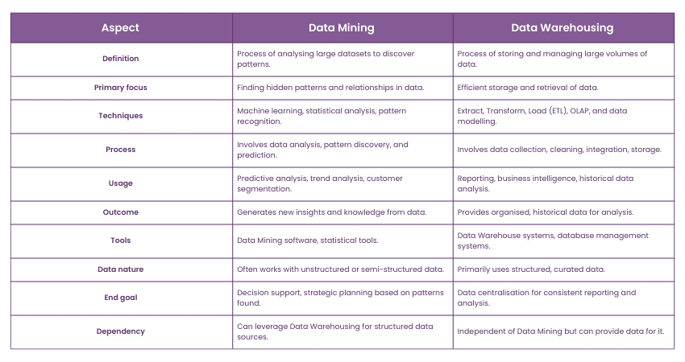
Data warehousing and Data mining

Slide 10
NoSQL

Slide 11
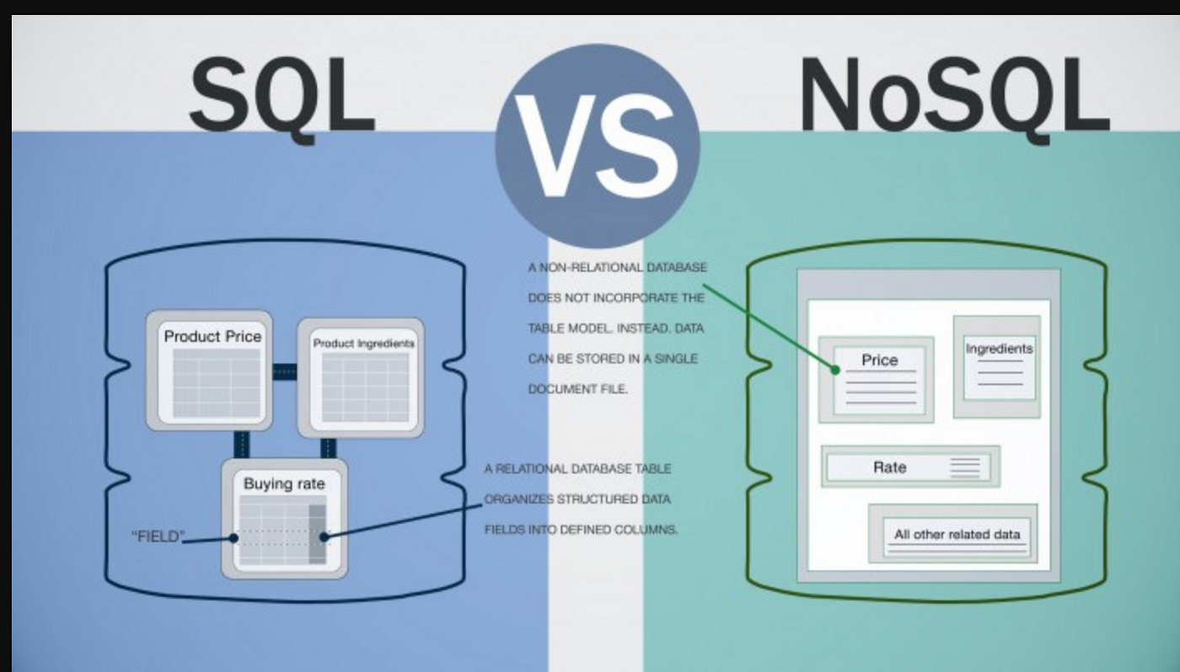
What is NoSQL?
NoSQL, also referred to as “not only SQL” or “non-SQL”.
It is an approach to database design that enables the storage and querying of data outside the traditional structures found in relational databases.

Slide 12
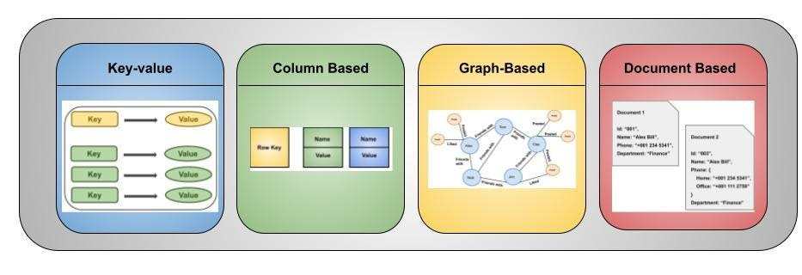
What is NoSQL?

Slide 13
End of Unit - 9

